Slide 1
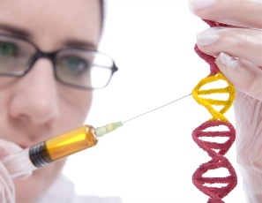
University of Basrah Al-zahraa medical college
Ministry of higher Education and Scientific Researches
The module: Molecular, Gene and Diseases
Session 2: Lec1
Lecture Title:
Protein Structure and Folding
Module staff:
Dr. Wamedh H. Alqatrani
Dr. Hussein K. Abdul-Sada
Dr. Nibras S. Al-Ammar
Dr. Ilham Mohammed
This Lecture was loaded in blackboard and you can find the material in:
(Lippincott’s Illustrated Reviews: Cell and Molecular Biology Chapters 2,3)
For more detailed instructions, any question, or you have a case you
need help in, please post to the group of session

Slide 2
University of Basrah Al-zahraa medical college
Ministry of higher Education and Scientific Researches
The Learning Objectives (LO)
At the end of this lecture you should be able to:
Describe what is meant by the primary, secondary, tertiary and quaternary structure of proteins. (LO 2.1)
Describe the types of bonds and forces involved in protein structure. (LO 2.2)
Explain the key features of the two major secondary structure elements of proteins (α-helix and β -sheet). (LO 2.3)

Slide 3
University of Basrah Al-zahraa medical college
Ministry of higher Education and Scientific Researches
Peptides & Proteins
LO 2.1
In peptides and proteins, the amino group of one amino acid is linked to the carboxyl group of the next amino acid, forming peptide bond, releasing water molecule.
The amino acid in a peptide chain is named amino acid residue.

Slide 4
University of Basrah Al-zahraa medical college
Ministry of higher Education and Scientific Researches
LO 2.1 & 2.2
A peptide chain may consists 2-50 amino acids.
By convention, the amino terminus (N-terminus) is taken as the first residue, and the sequence of amino acids is written from left to right.
Seryl glycyl tyrosyl alanyl leucine
Or
⁺ NH₃-Ser-Gly-Tyr-Ala-Leu-COO⁻

Slide 5
University of Basrah Al-zahraa medical college
Ministry of higher Education and Scientific Researches
Protein Structure
LO 2.1 & 2.2
Proteins contain between 50 and 2000 amino acid residues.
The mean molecular mass of an amino acid residue is about 110 Dalton units (Da). Therefore the molecular mass of most proteins is between 5.5 and 220 kDa
Proteins do not exist as linear polypeptides but fold into a unique 3-dimensional structure.

Slide 6
University of Basrah Al-zahraa medical college
Ministry of higher Education and Scientific Researches
Protein Structure
LO 2.1 & 2.2
The shape of the protein is important for defining the protein function.
The linear sequence of the linked amino acids contains the information necessary to generate a protein molecule with a unique three-dimensional shape.

Slide 7
University of Basrah Al-zahraa medical college
Ministry of higher Education and Scientific Researches
Diseases can be caused by
Changes in protein structure that affect the protein’s ability to bind other molecules and carry out its function.
&
Conformational changes in proteins that affect their solubility and degradability.
?

Slide 8
University of Basrah Al-zahraa medical college
Ministry of higher Education and Scientific Researches
Protein Structure
LO 2.1 & 2.2
There are four organizational levels of protein structure:
Primary
Secondary
Tertiary
Quaternary

Slide 9
University of Basrah Al-zahraa medical college
Ministry of higher Education and Scientific Researches
Protein Structure
LO 2.1, 2.2& 2.3
Primary Structure Of Proteins. The sequence of amino acids in a protein.

Slide 10
University of Basrah Al-zahraa medical college
Ministry of higher Education and Scientific Researches
Protein Structure
Primary Structure Of Proteins
loss or impairment of normal function
Abnormal amino acid sequence
incorrect folding
GENETIC DISEASE

Slide 11
University of Basrah Al-zahraa medical college
Ministry of higher Education and Scientific Researches
Protein Structure
LO 2.1, 2.2& 2.3
Primary Structure Of Proteins
The bonds responsible for the stabilization of primary structure is only the peptide bonds.
Peptide bonds are not broken by heating or high concentrations of urea.
Prolonged exposure to a strong acid or base at elevated temperatures is required to hydrolyze these bonds.

Slide 12
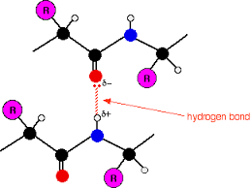
University of Basrah Al-zahraa medical college
Ministry of higher Education and Scientific Researches
Protein Structure
LO 2.1, 2.2& 2.3
Secondary Structure of Proteins
The polypeptide forms regular arrangements of amino acids that are
located near to each other in the linear sequence.

Slide 13
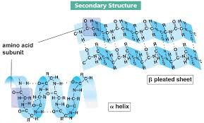
University of Basrah Al-zahraa medical college
Ministry of higher Education and Scientific Researches
Protein Structure
LO 2.1, 2.2& 2.3
Secondary Structure of Proteins
Examples of secondary structure:
α-helix
β-sheet

Slide 14
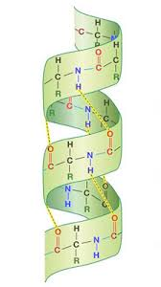
University of Basrah Al-zahraa medical college
Ministry of higher Education and Scientific Researches
Protein Structure
LO 2.1, 2.2& 2.3
A. The Alpha Helix
Is a Coiled Structure Stabilized by Intra-chain Hydrogen Bonds
Thus, amino acid spaced three or four apart in the primary sequence
are close together in α-helix.
Most common polypeptide helices.
Stable rigid conformation.
The core of the helix is tightly packed, thereby
maximizing association energies between atoms.

Slide 15
University of Basrah Al-zahraa medical college
Ministry of higher Education and Scientific Researches
Protein Structure
LO 2.1, 2.2& 2.3
Amino acids that disrupt an α-Helix
Proline.
Large numbers of charged amino acid.
Large numbers of amino acids with bulky side chains, such as tryptophan, or amino acids, such as valine or isoleucine, that branch at the β-carbon

Slide 16
University of Basrah Al-zahraa medical college
Ministry of higher Education and Scientific Researches
Protein Structure
LO 2.1, 2.2& 2.3
B. β-Sheet:
Extended conformation in which the side chains (green) are alternately above and below the plane of the strand.
all of the peptide bond components are involved in hydrogen bonding
The amino acid residues of a β sheet form a zigzag in which the R groups of adjacent residues is in opposite directions.

Slide 17
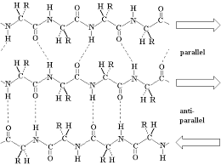
University of Basrah Al-zahraa medical college
Ministry of higher Education and Scientific Researches
Protein Structure
LO 2.1, 2.2& 2.3
β-Sheet may be:
Parallel
Antiparallel

Slide 18
University of Basrah Al-zahraa medical college
Ministry of higher Education and Scientific Researches
Protein Structure
LO 2.1, 2.2& 2.3
Parallel β-Sheet
Adjacent β-strands run in the same direction.
Hydrogen bonds connect each amino acid on one strand with two different amino acids on the adjacent strand.

Slide 19
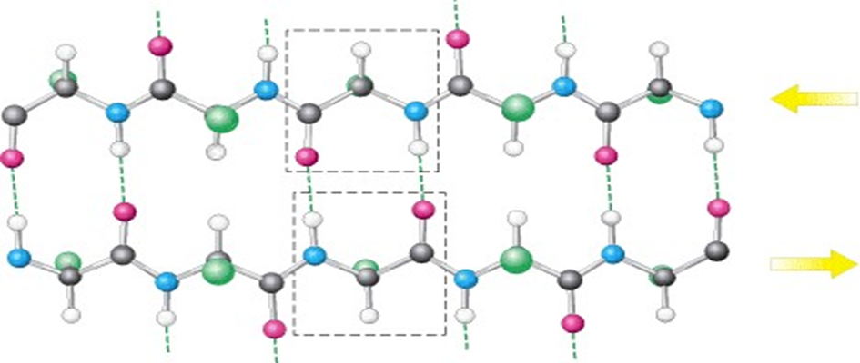
University of Basrah Al-zahraa medical college
Ministry of higher Education and Scientific Researches
Protein Structure
LO 2.1, 2.2& 2.3
Antiparallel β Sheet:
Adjacent β strands run in opposite directions.
Hydrogen bonds between NH and CO groups connect each amino acid to a single amino acid on an adjacent strand, stabilizing the structure.

Slide 20
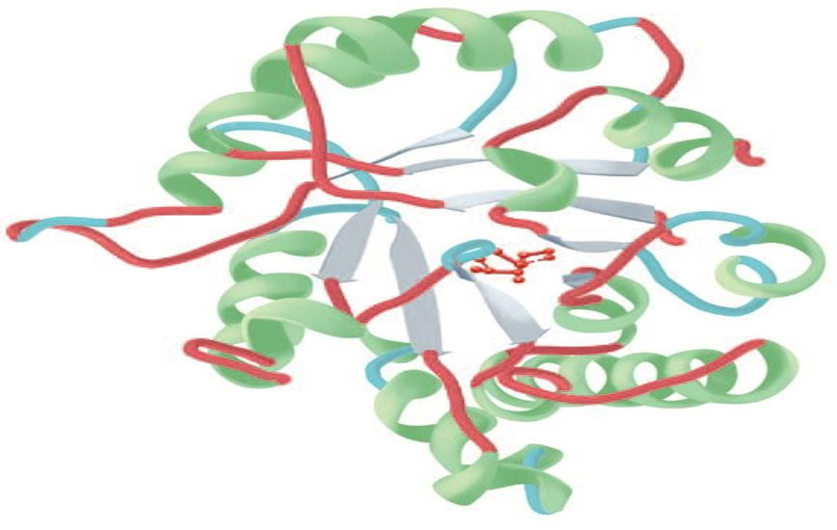
University of Basrah Al-zahraa medical college
Ministry of higher Education and Scientific Researches
Protein Structure
LO 2.1, 2.2& 2.3
β Sheet in Globular Proteins:
Most β sheets are not flat but have a right- handed twist.
Clusters of twisted strands of β sheet form the core of many globular proteins.

Slide 21
University of Basrah Al-zahraa medical college
Ministry of higher Education and Scientific Researches
Protein Structure
LO 2.1 & 2.2
Tertiary Structure of proteins
Folding up of the secondary structures, so that amino acids far apart in the primary sequence may interact, and a 3-dimensional structure is formed.
Polypeptide chains that are greater than ~200 amino acids in length generally consist of two or more domains.
Domains are regions of the polypeptide that have distinct structures and serve particular roles (e.g. ligand binding, interaction with other proteins etc.)

Slide 22
University of Basrah Al-zahraa medical college
Ministry of higher Education and Scientific Researches
Protein Structure
LO 2.1 & 2.2
Tertiary Structure of proteins
Tertiary structure of protein is stabilized by different types of bonds and interactions between amino acids R groups.
These include Covalent (disulphide) bonds, Hydrophobic interactions, Ionic interactions, Hydrogen bonds &Van der Waals interaction.
Example: myoglobin (1 polypeptide chain monomeric proteins)

Slide 23
University of Basrah Al-zahraa medical college
Ministry of higher Education and Scientific Researches
Protein Structure
LO 2.1 & 2.2
Tertiary Structure of proteins
Tertiary structure of protein is stabilized by different types of bonds and interactions between amino acids R groups.
These include Covalent (disulphide) bonds, Hydrophobic interactions, Ionic interactions, Hydrogen bonds &Van der Waals interaction.
Example: myoglobin (1 polypeptide chain monomeric proteins)

Slide 24
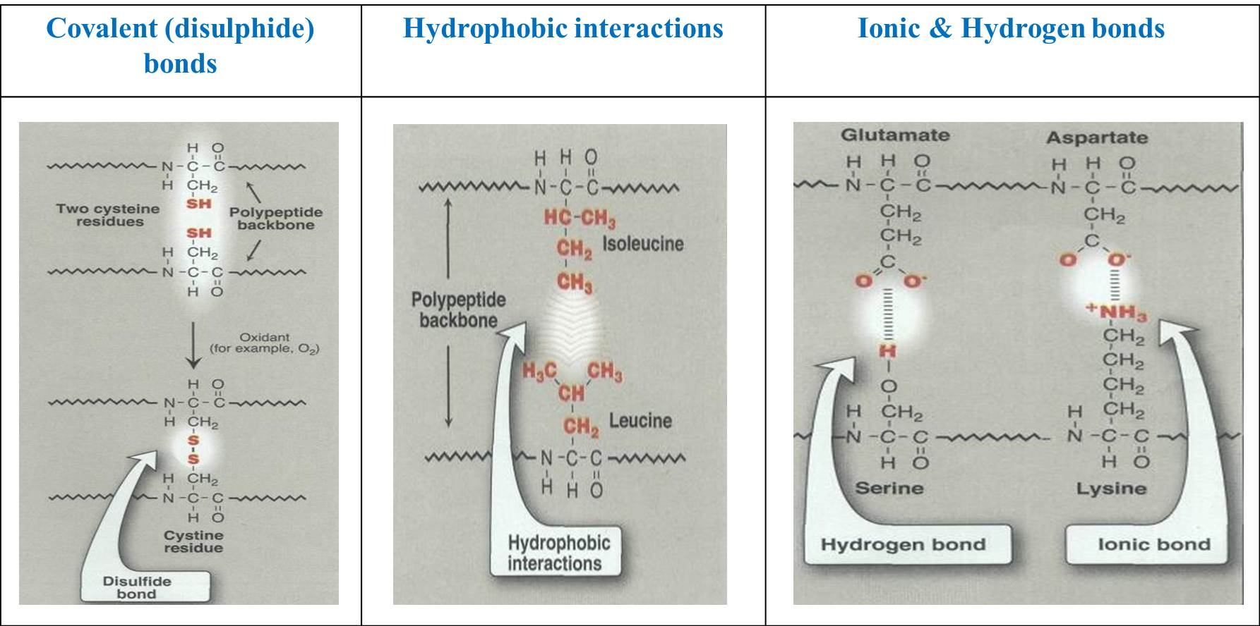
University of Basrah Al-zahraa medical college
Ministry of higher Education and Scientific Researches
Protein Structure
LO 2.1 & 2.2
Tertiary Structure of proteins

Slide 25
University of Basrah Al-zahraa medical college
Ministry of higher Education and Scientific Researches
Protein Structure
LO 2.1 & 2.2
Protein folding Protein folding
A complex process by which tertiary structures form within the cell.
Occurs within the cell in seconds to minutes.
The information needed for correct protein folding is contained in the primary structure of the polypeptide, however, a specialized group of proteins, named chaperones, are required for the proper folding of many species of proteins.

Slide 26
University of Basrah Al-zahraa medical college
Ministry of higher Education and Scientific Researches
Protein Structure
LO 2.1 & 2.2
Protein folding Protein folding
The side chains of highly polar amino acids tend to reside on the exterior of proteins, where they can form hydrogen bonds with water.
The side chains of nonpolar amino acids are normally clustered in the interior of proteins to shield them from water.

Slide 27
University of Basrah Al-zahraa medical college
Ministry of higher Education and Scientific Researches
Protein Structure
LO 2.1 & 2.2
Quaternary Structure
Quaternary structure: The arrangement of subunits (each subunit is poly peptide) in proteins.
The polypeptide chains may be identical (homomeric) or different (heteromeric).
Hemoglobin is an example of heteromeric protein

Slide 28
University of Basrah Al-zahraa medical college
Ministry of higher Education and Scientific Researches
Protein Structure
LO 2.1 & 2.2
Quaternary Structure
The same types of bonds, that involved in tertiary structure, stabilize Quaternary structure.
Some proteins contain covalent disulfide (S—S) bonds that link the sulfhydryl groups of cys residues.
Intra-polypeptide disulfide bonds stabilize 3-D structure of peptide.
inter-polypeptide disulfide bonds (between subunits) stabilize the quaternary structure of proteins

Slide 29
University of Basrah Al-zahraa medical college
Ministry of higher Education and Scientific Researches
Protein Structure
LO 2.1 & 2.2
Types of protein structure
Proteins can be categorized into 2 major groups depending of their higher order structure: Globular or Fibrous.
Most enzymes and regulatory proteins in a cell are globular proteins whereas fibrous proteins provide structure, support and protection.

Slide 30
University of Basrah Al-zahraa medical college
Ministry of higher Education and Scientific Researches
Protein Structure
LO 2.1 & 2.2
Protein Denaturation
The loss of protein structure sufficient to cause the loss of function is known as denaturation.
Denaturation is brought about by breaking the bonds that hold that maintain the protein’s tertiary and secondary structure.
Denaturing agents include heat, organic solvents, mechanical mixing, strong acids or bases , detergents, and ions of heavy metals such as lead and mercury.

Slide 31
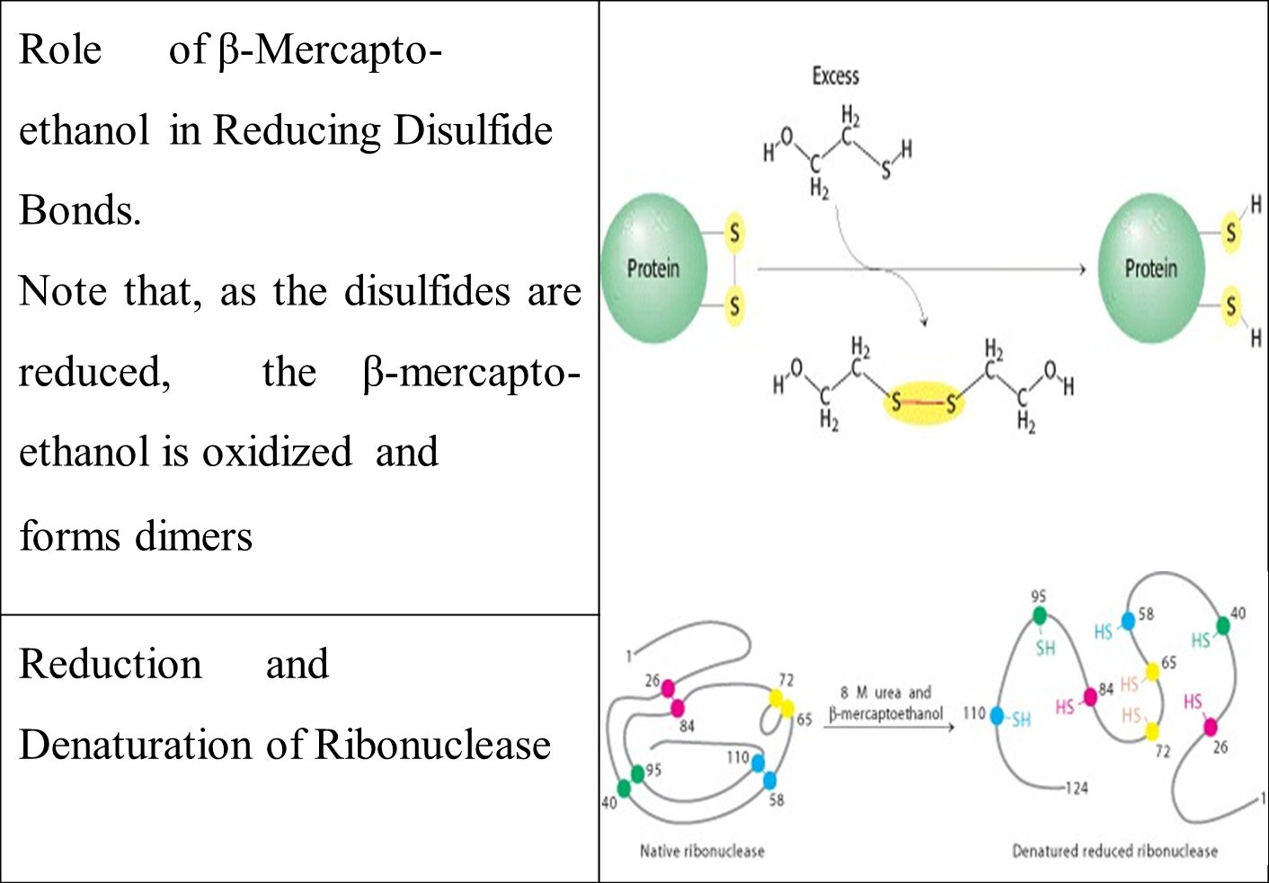
University of Basrah Al-zahraa medical college
Ministry of higher Education and Scientific Researches
Protein Structure
LO 2.1 & 2.2
Protein Denaturation

Slide 32
University of Basrah Al-zahraa medical college
Ministry of higher Education and Scientific Researches
Questions
Which of the following characterize alpha-helix regions of proteins?
They all have the same primary structure.
They are formed principally by hydrogen bonds between a carbonyl oxygen atom in one peptide bond and the amide hydrogen from a different peptide bond.
They are formed principally by hydrogen bonds between a carbonyl atom in one peptide bond and the hydrogen atoms on the side chain of another amino acid.
They are formed by hydrogen bonding between two adjacent amino acids in the primary sequence.
They require a high content of proline and glycine.

Slide 33
University of Basrah Al-zahraa medical college
Ministry of higher Education and Scientific Researches
Questions
Which of the following is a characteristic of globular proteins?
Hydrophilic amino acids tend to be on the inside.
Hydrophobic amino acids tend to be on the outside.
Tertiary structure is formed by hydrophobic and electrostatic interactions between amino acid side chains and by hydrogen bonds between peptide bonds.
Secondary structures are formed principally by hydrophobic interactions between amino acids.
Covalent disulfide bonds are necessary to hold the protein in a rigid conformation.

Slide 34
University of Basrah Al-zahraa medical college
Ministry of higher Education and Scientific Researches
Questions
A protein has one transmembrane domain composed entirely of helical secondary structure. Which of the following amino acids would you expect to find in the transmembrane domain?
Proline
Glutamate
Lysine
Leucine
Arginine

